Slide 1
Mastering Embedded System Online Diploma www.learn-in-depth.com First Term (Final Project 1 ) Eng. Nader Mohamed Nader My Profile : Nader Mohamed | Profile (learn-in-depth-store.com)
Notes:
ID=d924773e-9a16-4d6d-9803-8cb819e99682 Recipe=text_billboard Type=TextOnly Variant=0 FamilyID=AccentBoxWalbaum_Zero

Slide 2
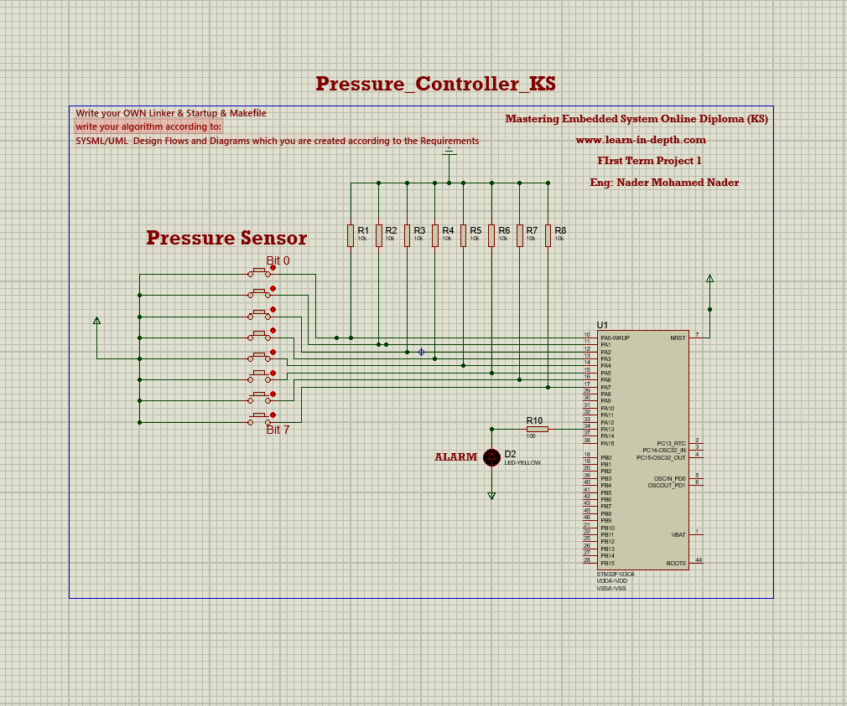

Title: Pressure detector Client Requirement: A pressure sensor and an alarm A pressure controller system for cabin safety. Alert crew members when cabin pressure exceeds a safe threshold.

Slide 3
System Specification Pressure Threshold: Alarm triggers when pressure exceeds 20 bars. Alarm Duration: Alarm sounds for 60 seconds upon activation.

Slide 4
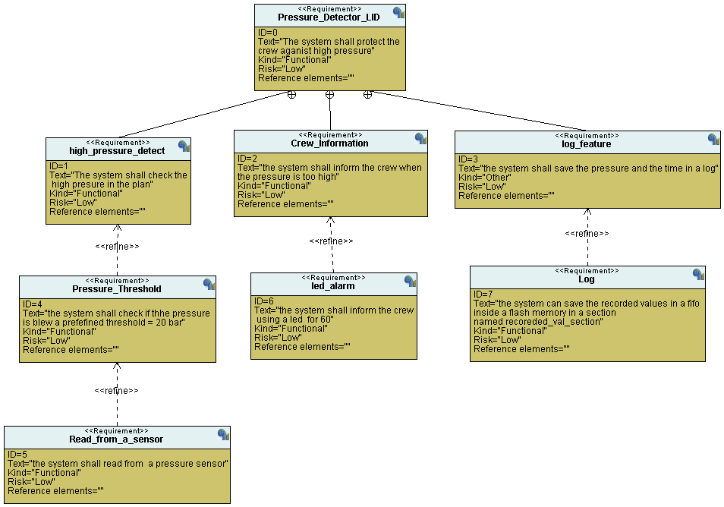
UML

Slide 5
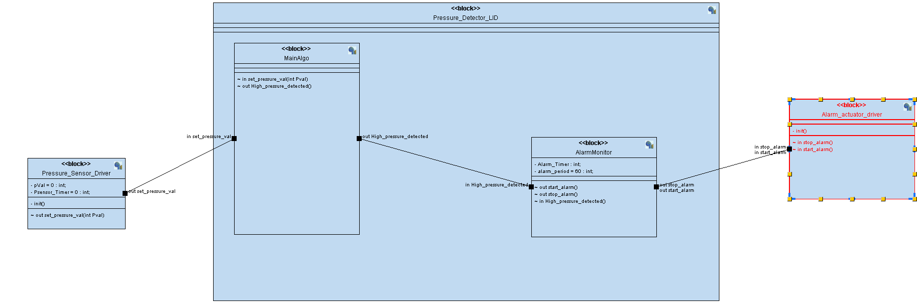
Blocks

Slide 6
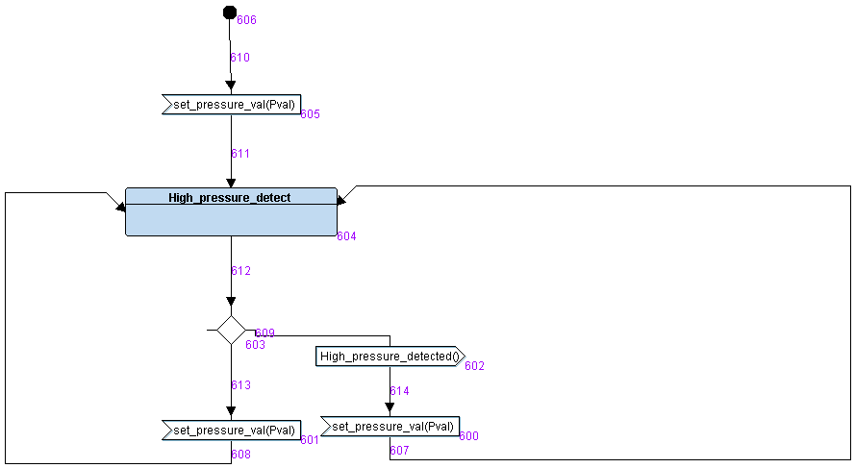
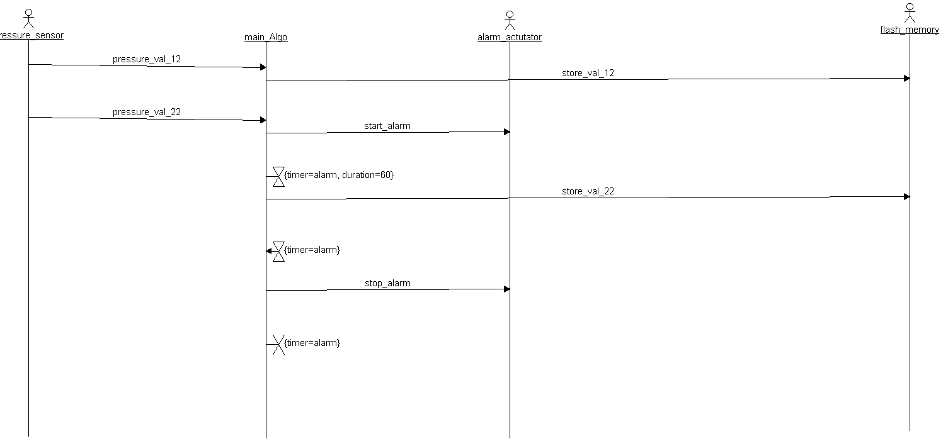
Main technique and Sequence diagram

Slide 7
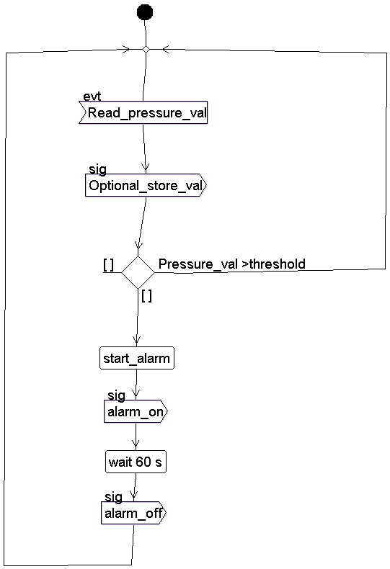
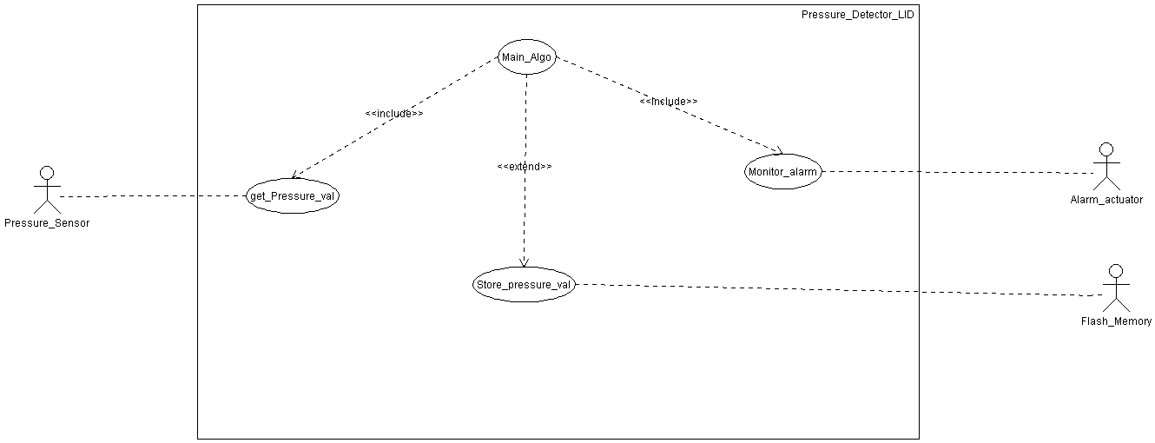
Sequence diagram and Case diagram

Slide 8


Project files and Tools
Repo URL
Report URL

